Slide 1
A Time Series Analysis of Gas Prices in the U.S.
Presented By
Amy Chuang |Apurva Kenekar |Heet Shah

Slide 2
Contents
Introduction
Decomposition Models
Smoothing Models
Regression Models
ARIMA Models
Change Point Analysis
Final Model

Slide 3
Introduction

Slide 4
Interest
Almost relevant to everyone.
Individual: directly impact on the price we pay for gasoline.
Economic: affect on business costs (eg. shipping), crowd out consumer discretionary spending.
International: crude oil is an important strategic resource.
Objective
The significance of gasoline driven us to create a predictive model for gasoline price.

Slide 5
Time series data
Source: U.S. Energy Information Administration
Data: Monthly Gasoline Retail Prices in U.S.D.
(Jan 1992 - Dec 2017)
Train Set: Gasoline price from Jan 1992-Dec 2016, 300 observations
Test Set: Gasoline price from Jan 2017-Dec 2017, 12 observations

Slide 6
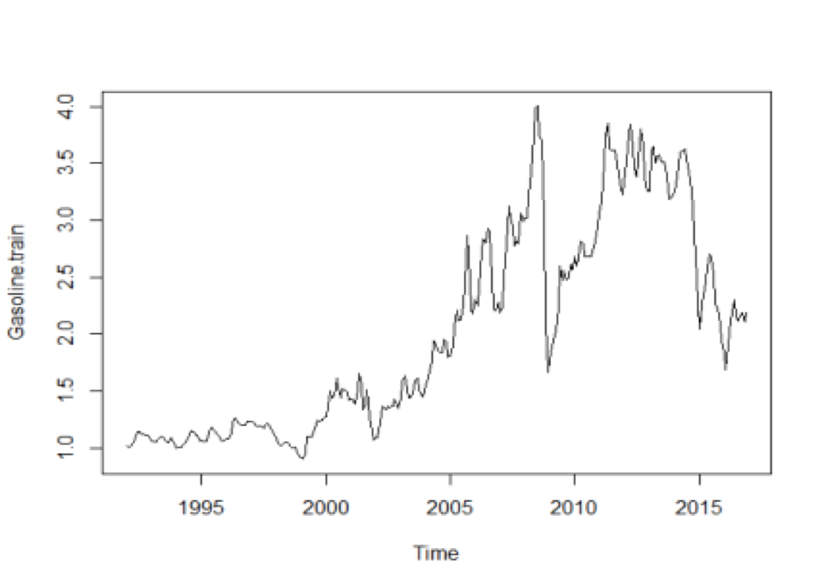
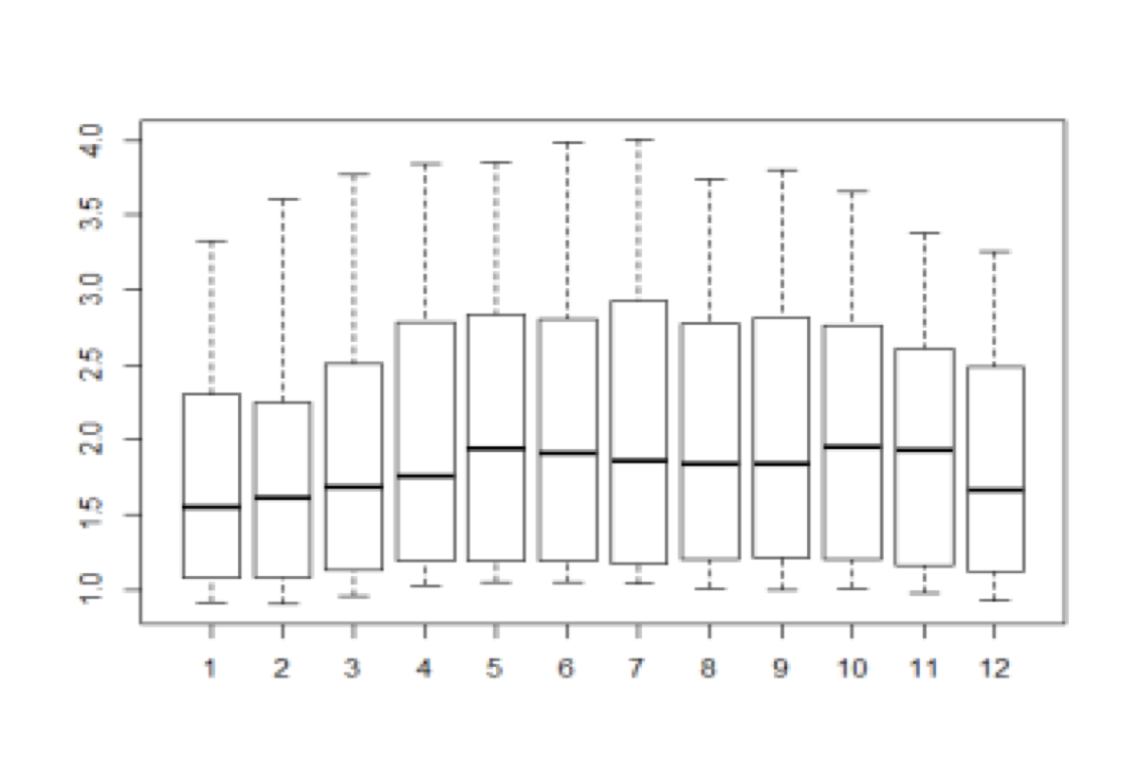
TS Plot & Box plot

Slide 7
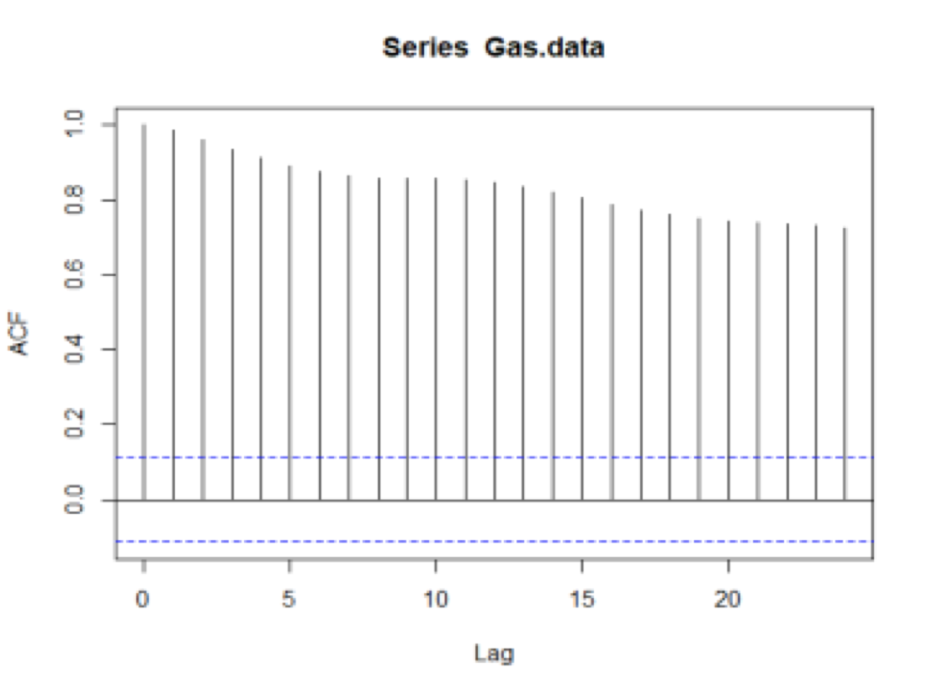
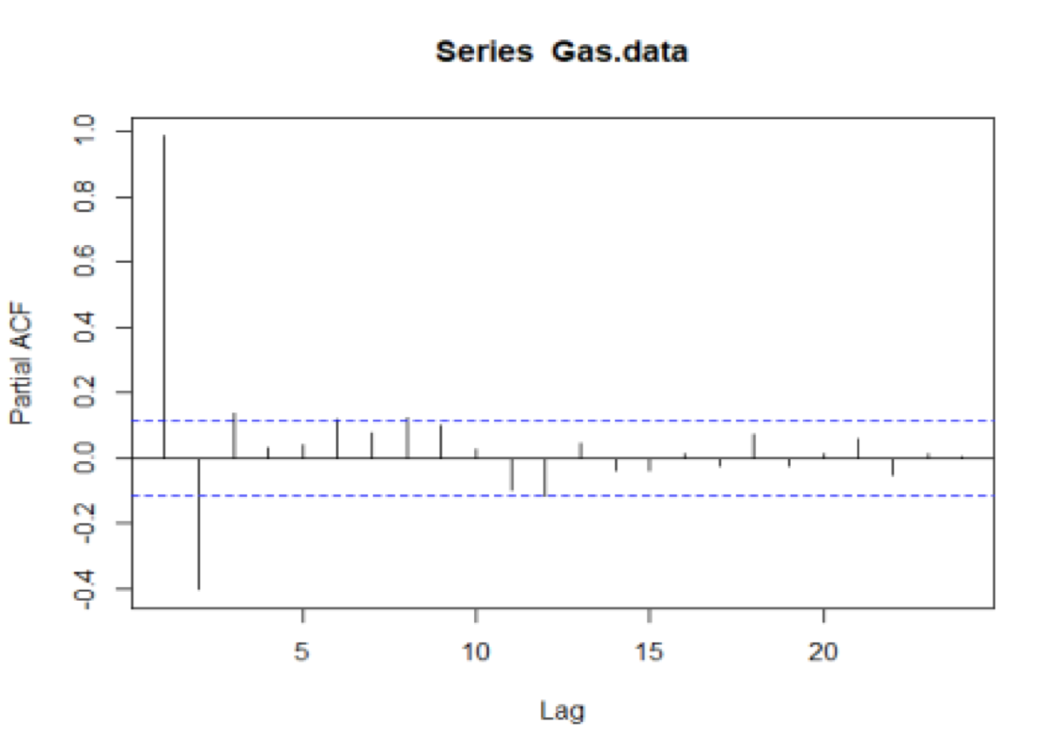
ACF & PACF plots

Slide 8
Decomposition Models

Slide 9
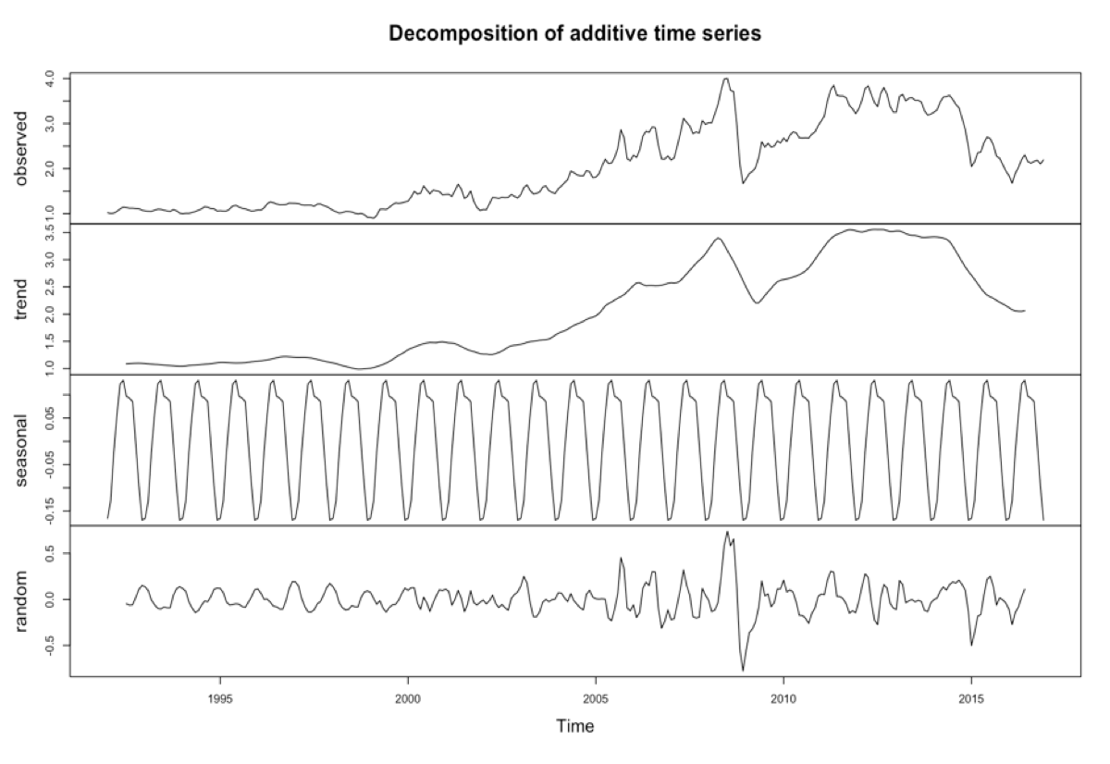
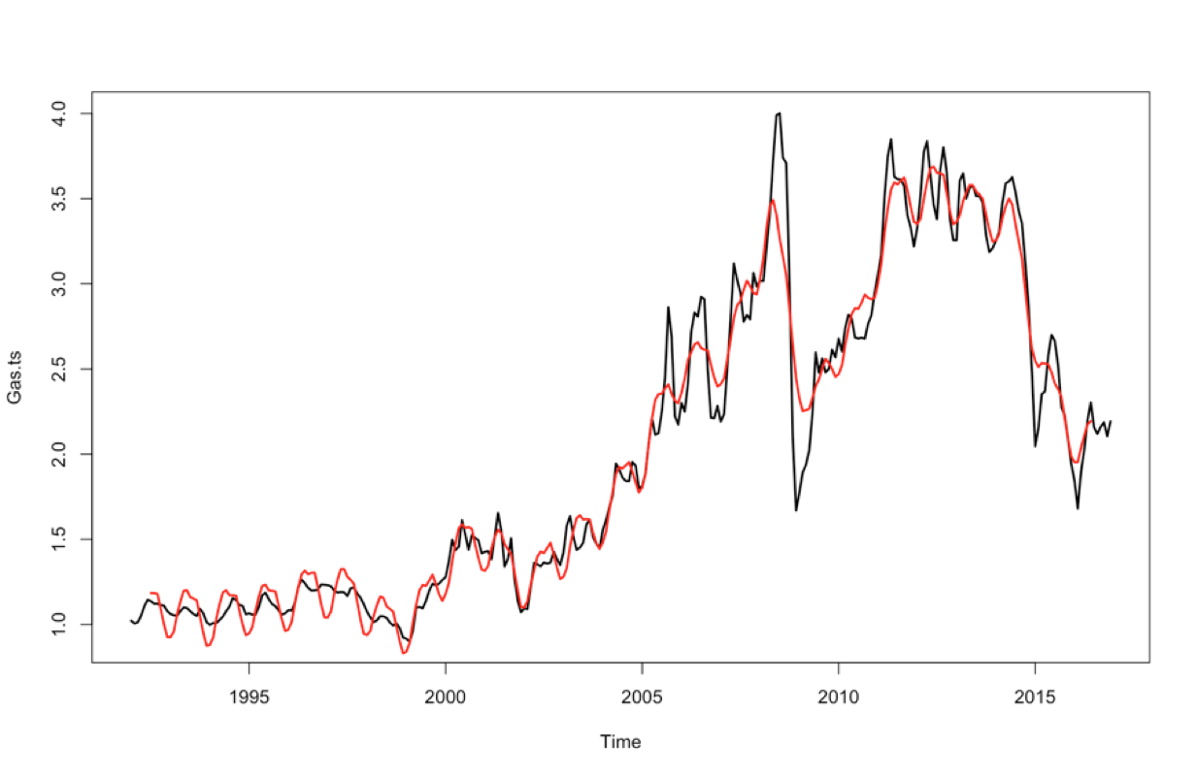
Decompose() Additive

Slide 10
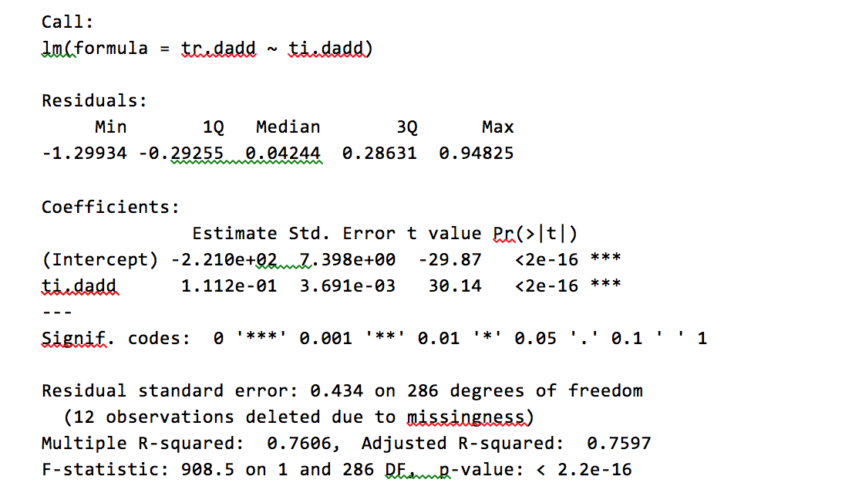
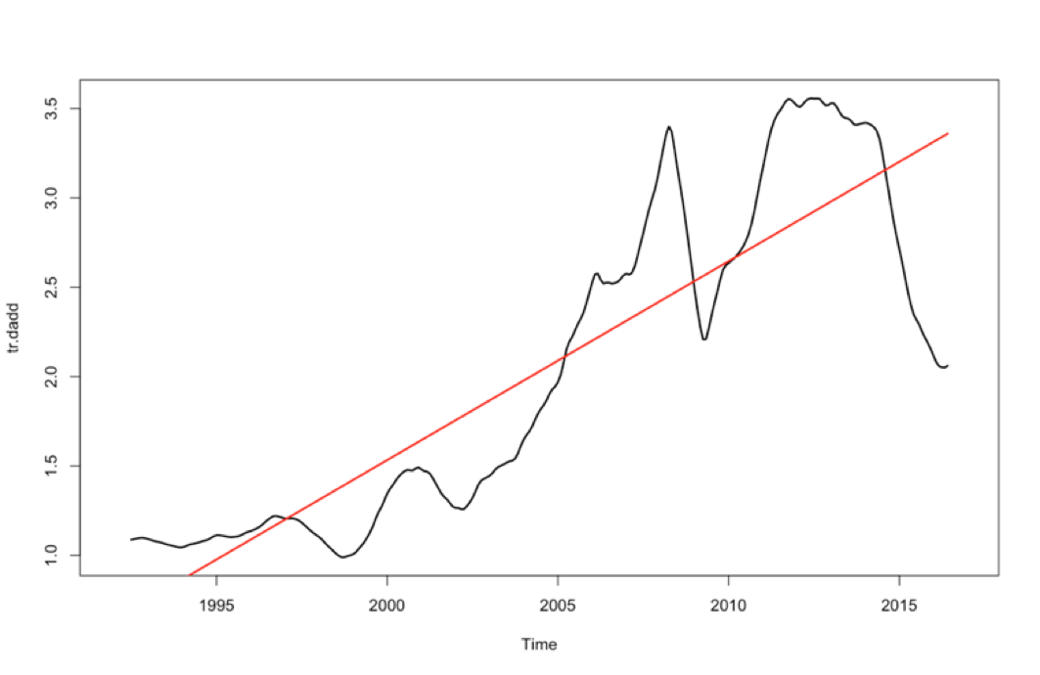
Decompose () Additive

Slide 11
Test RMSE
> sd(Gas.ts[7:294])
[1] 0.9180352
Additive decompose () Model:
> rmse.dadd
[1] 0.1646889
> rmse.dadd
[1] 1.149457
Multiplicative decompose () Model:
> rmsedm
[1] 0.1542288
> rmse.dmult
[1] 1.15645
Additive STL () Model:
> stladd.rmse
[1] 0.1527672
> rmse.sadd
[1] 1.033828
Multiplicative STL () Model:
> stlmult.rmse
[1] 0.1465828
> rmse.stl
[1] 1.359754

Slide 12
Holt-Winters (Multiplicative)

Slide 13
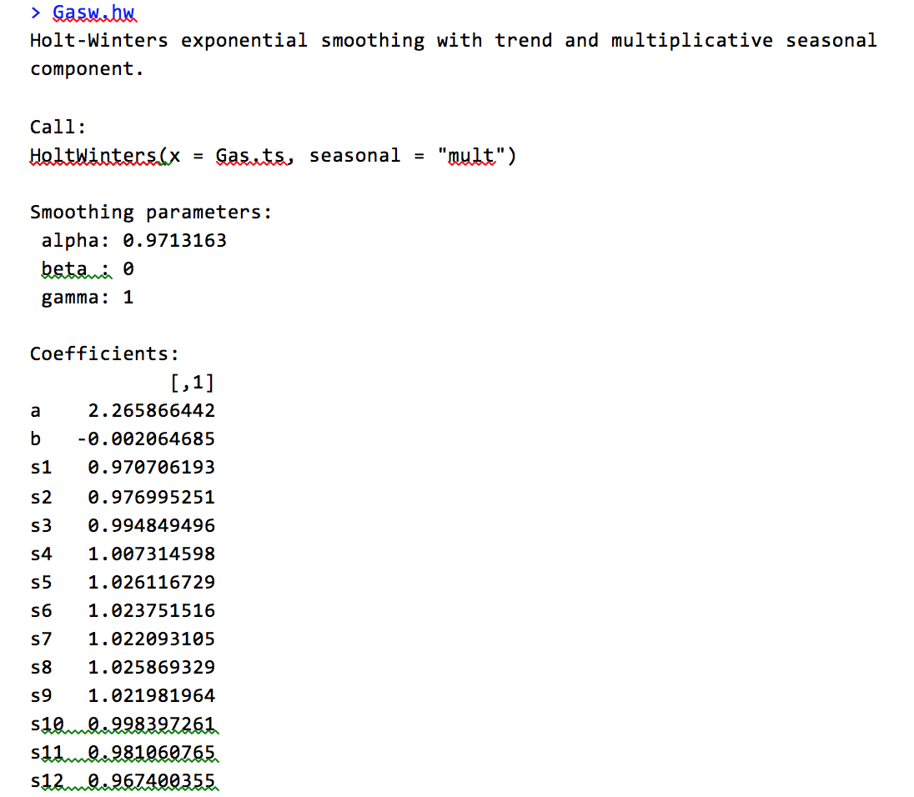
H-W Model
> rmse
[1] 0.137288
> rmse.hw
[1] 0.1461951 (lowest of all models)

Slide 14
Regression Models

Slide 15
Process
Fit the model : First order-> Quadratic-> Cubic ->
Log Y+Cubic -> Add Inflation
Examine the assumption plots
Plot fitted values against the actual data
Residuals plot
Test RMSE

Slide 16
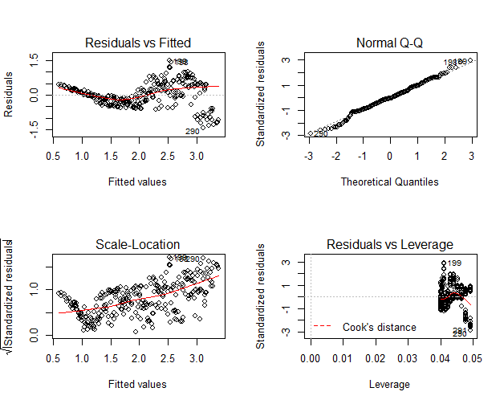
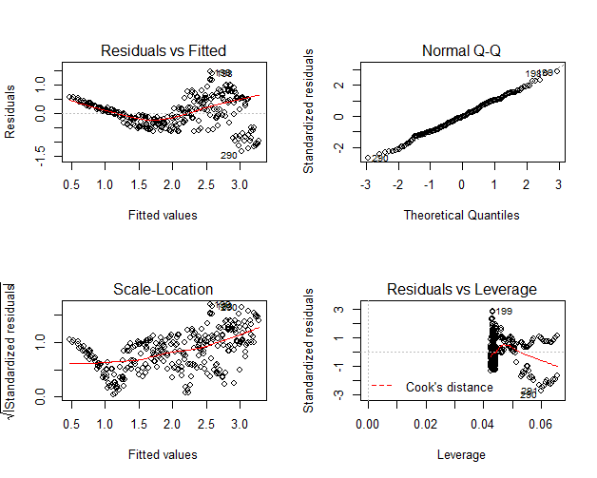
Assumptions diagnostic tests
First Order
Quadratic

Slide 17
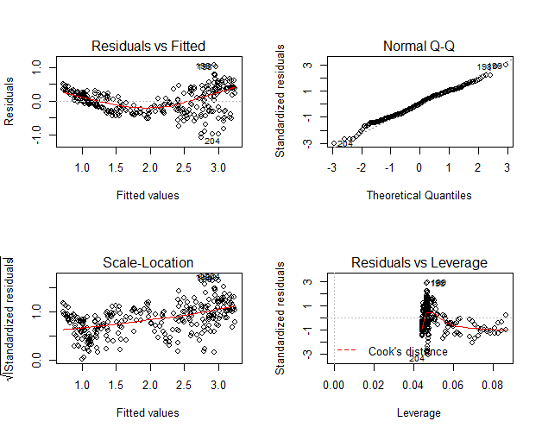
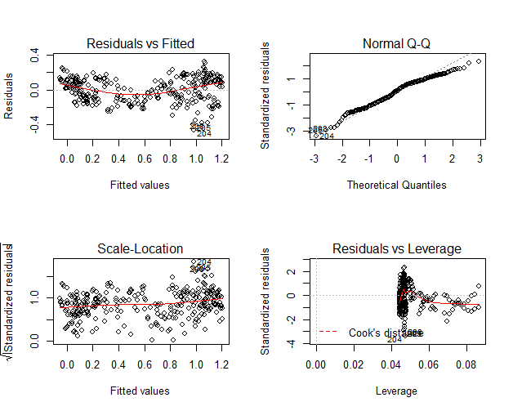
Assumptions diagnostic tests
Cubic
Log Y+ Cubic

Slide 18
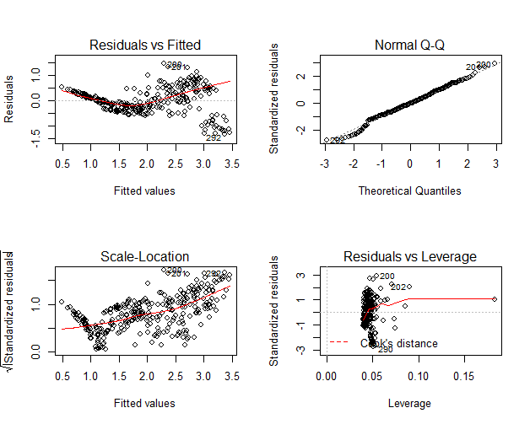
Assumptions diagnostic tests
On adding Inflation

Slide 19
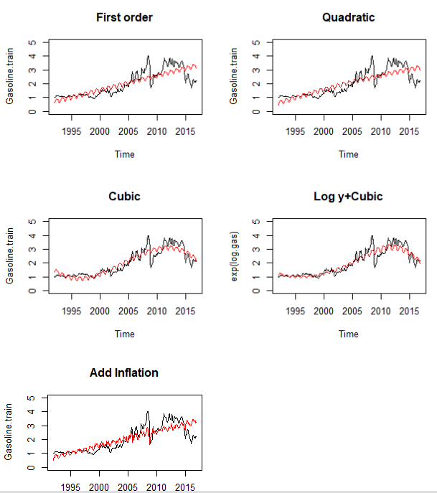
Fitted Values vs. Actual data

Slide 20
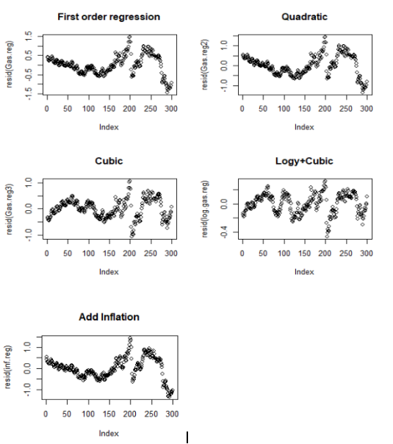
Residual Plots

Slide 21
Test RMSE
> rmse.Gas.reg
[1] 1.034282
> rmse.quadra
[1] 0.9046279
> rmse.cubic
[1] 0.366155
> rmse.logy.cubic
[1] 0.3247484
> rmse.inf
[1] 0.493808

Slide 22
SARIMA Models

Slide 23
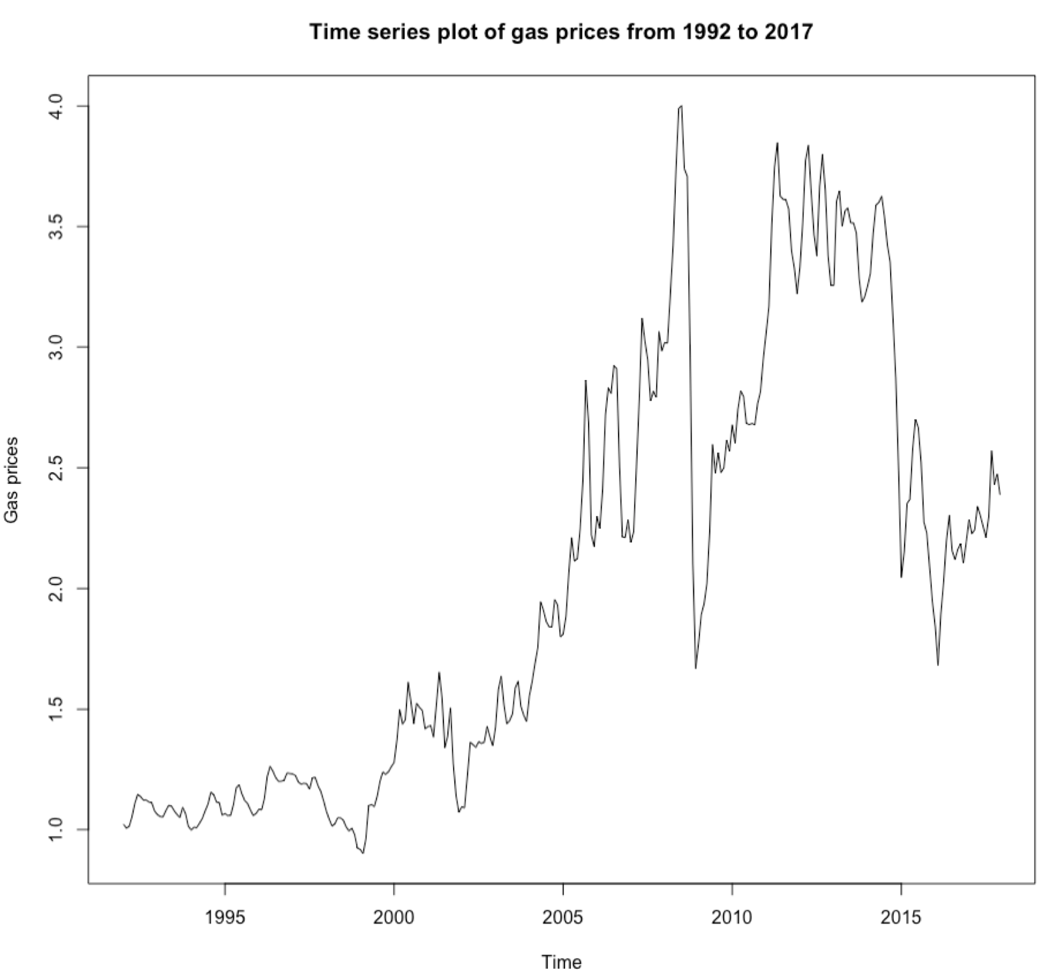
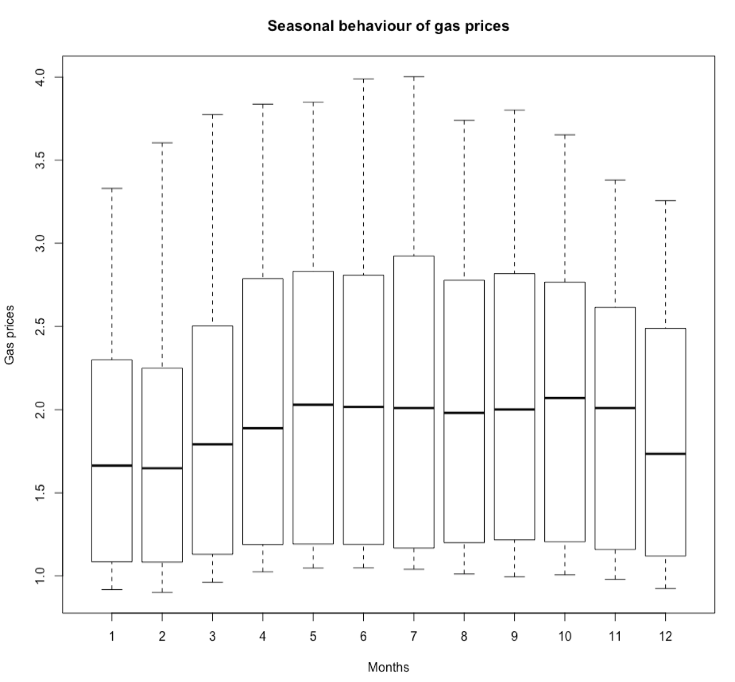
A recap of the characteristics of the series
Non stationary | Increasing Variance | Seasonality

Slide 24
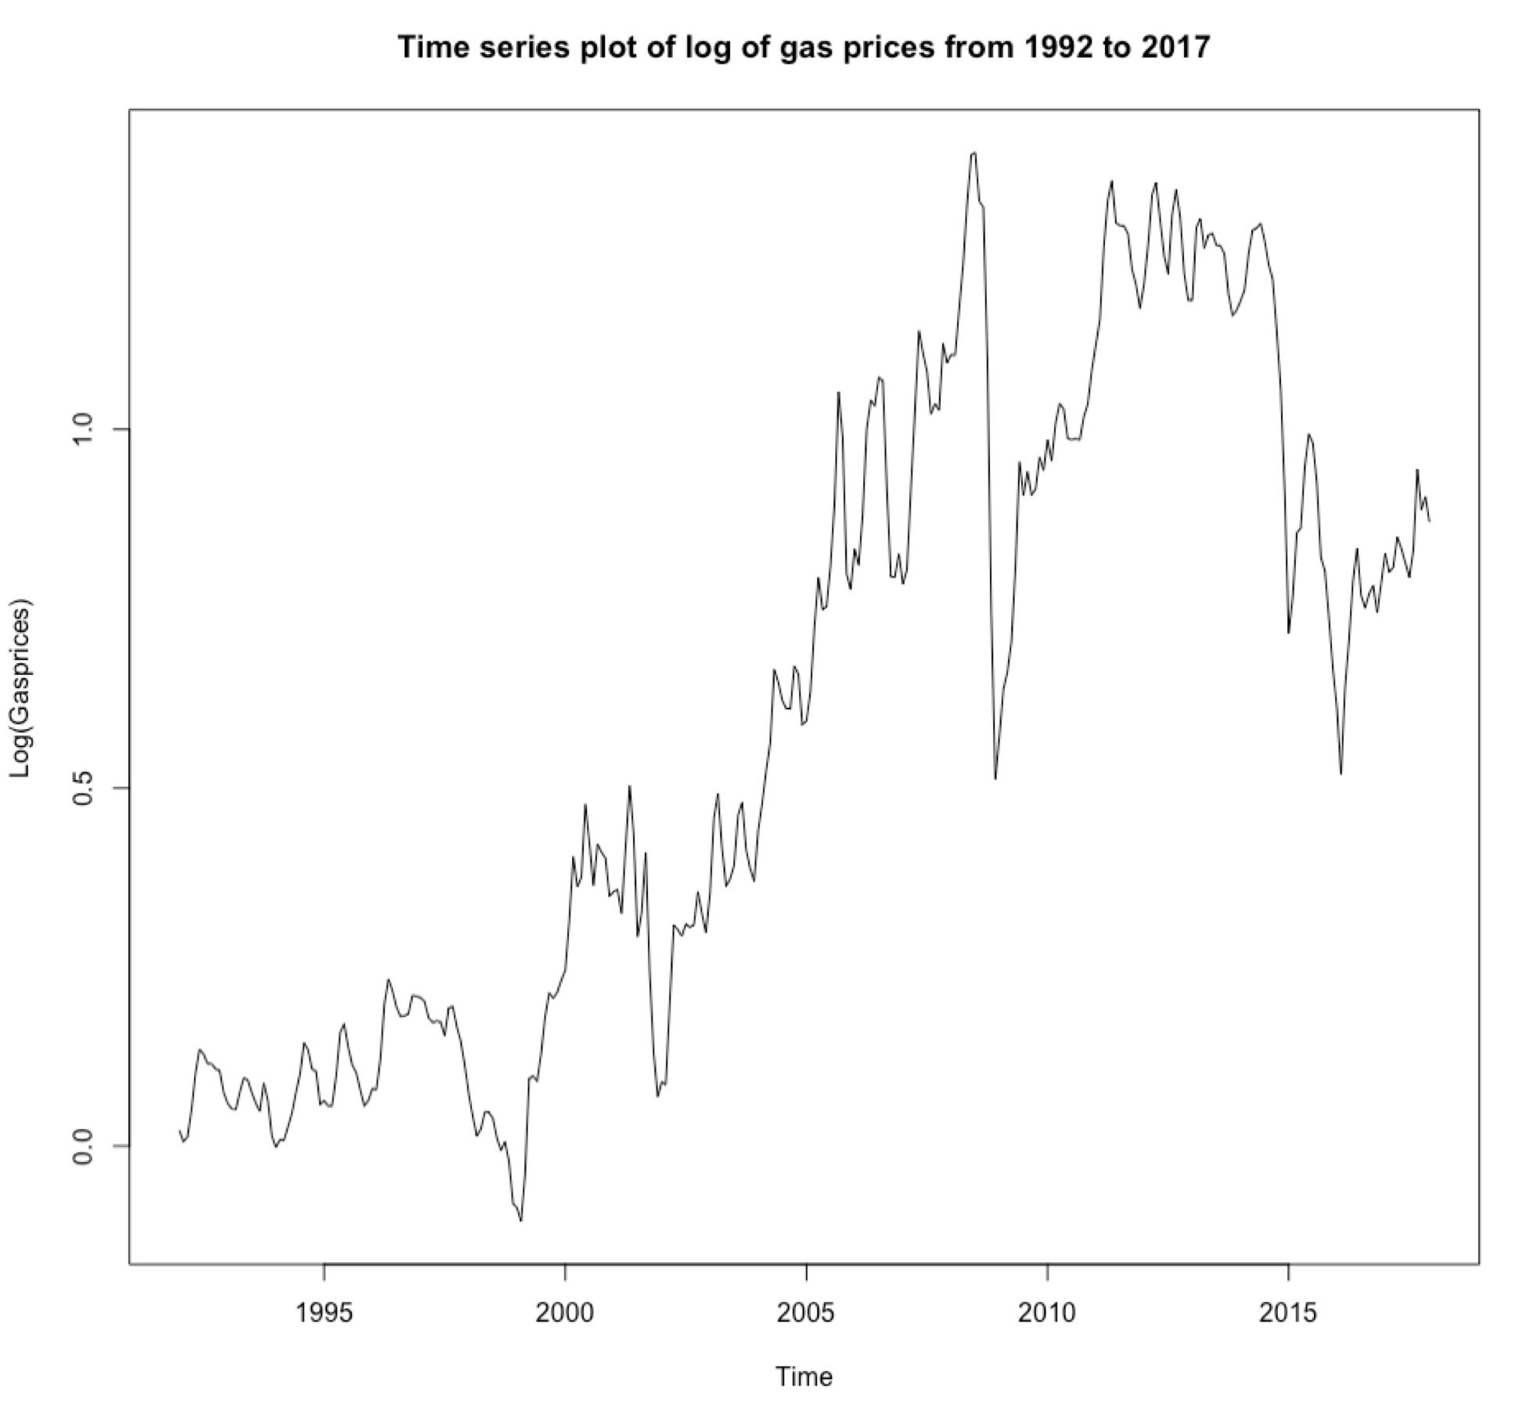
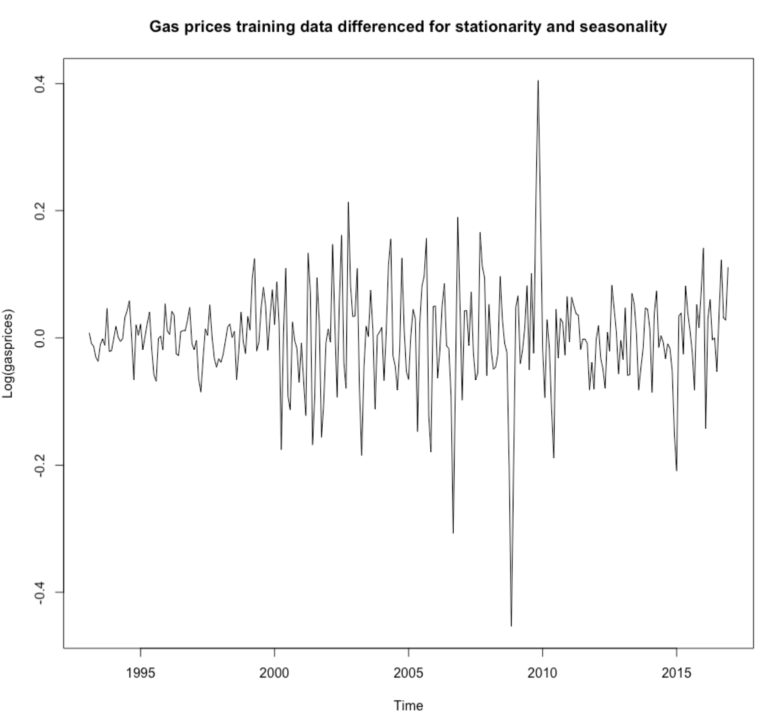
Log transformation and Differencing

Slide 25
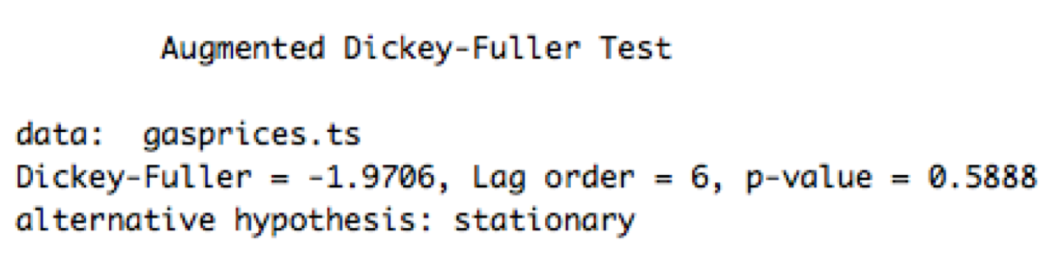
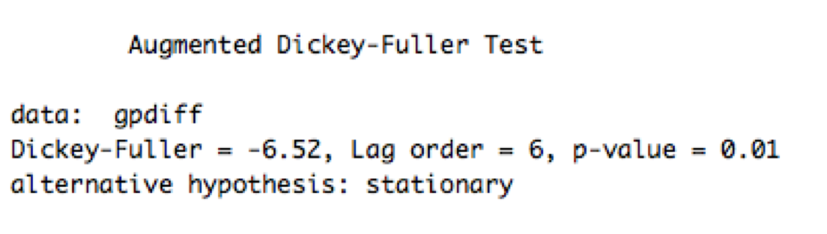
Augmented Dickey Fuller Test
Before log transformation & differencing
After log transformation & differencing
Null hypothesis cannot be rejected, hence there is insufficient evidence to prove the series is stationary
Null hypothesis is rejected, hence there is sufficient evidence to prove the series is stationary

Slide 26
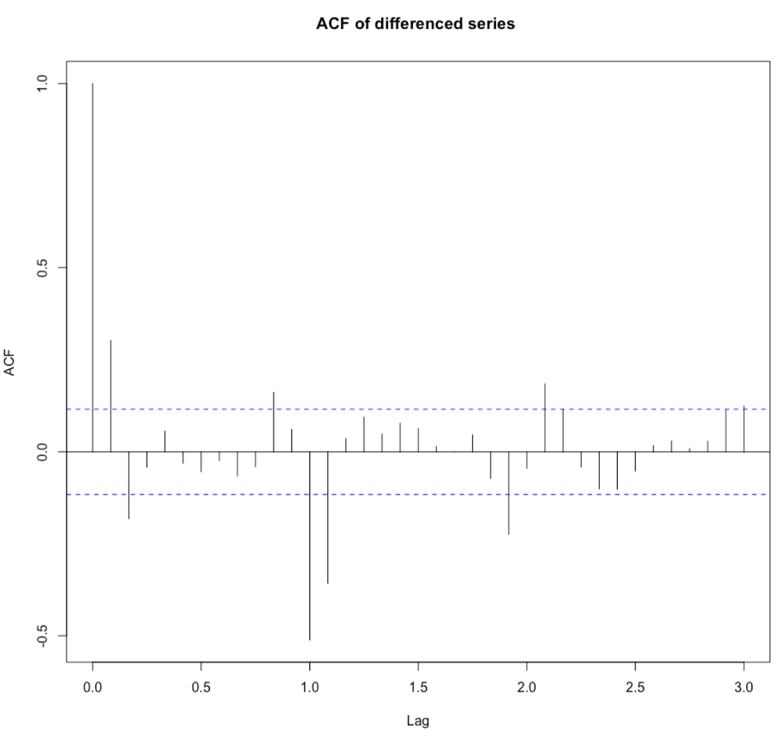
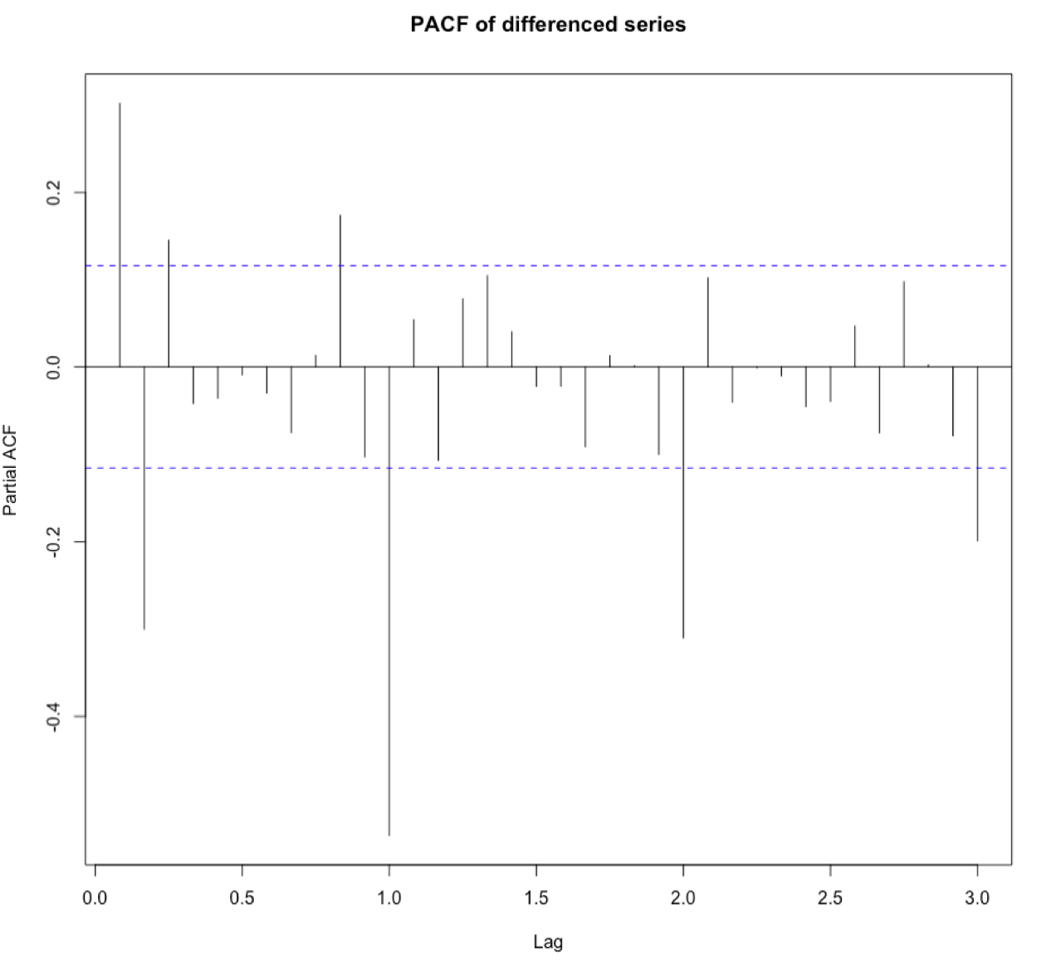
ACF & PACF of differenced log series
Non-seasonal components : Cuts off after lag 2
Seasonal components : Cuts off after lag 12
Non-seasonal components : Mixture of exponential decay and damped sine function
Seasonal components : Lag 12, 24,36 decay exponentially

Slide 27
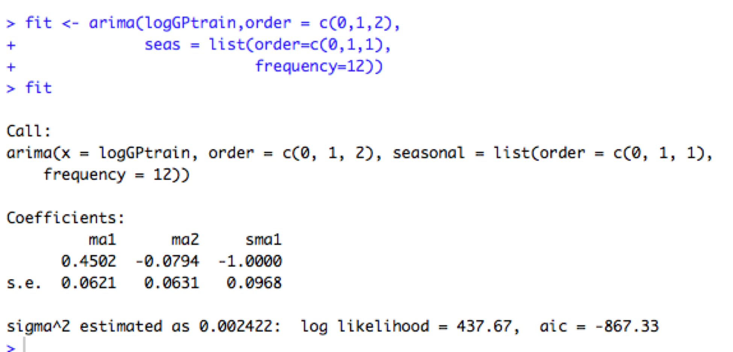
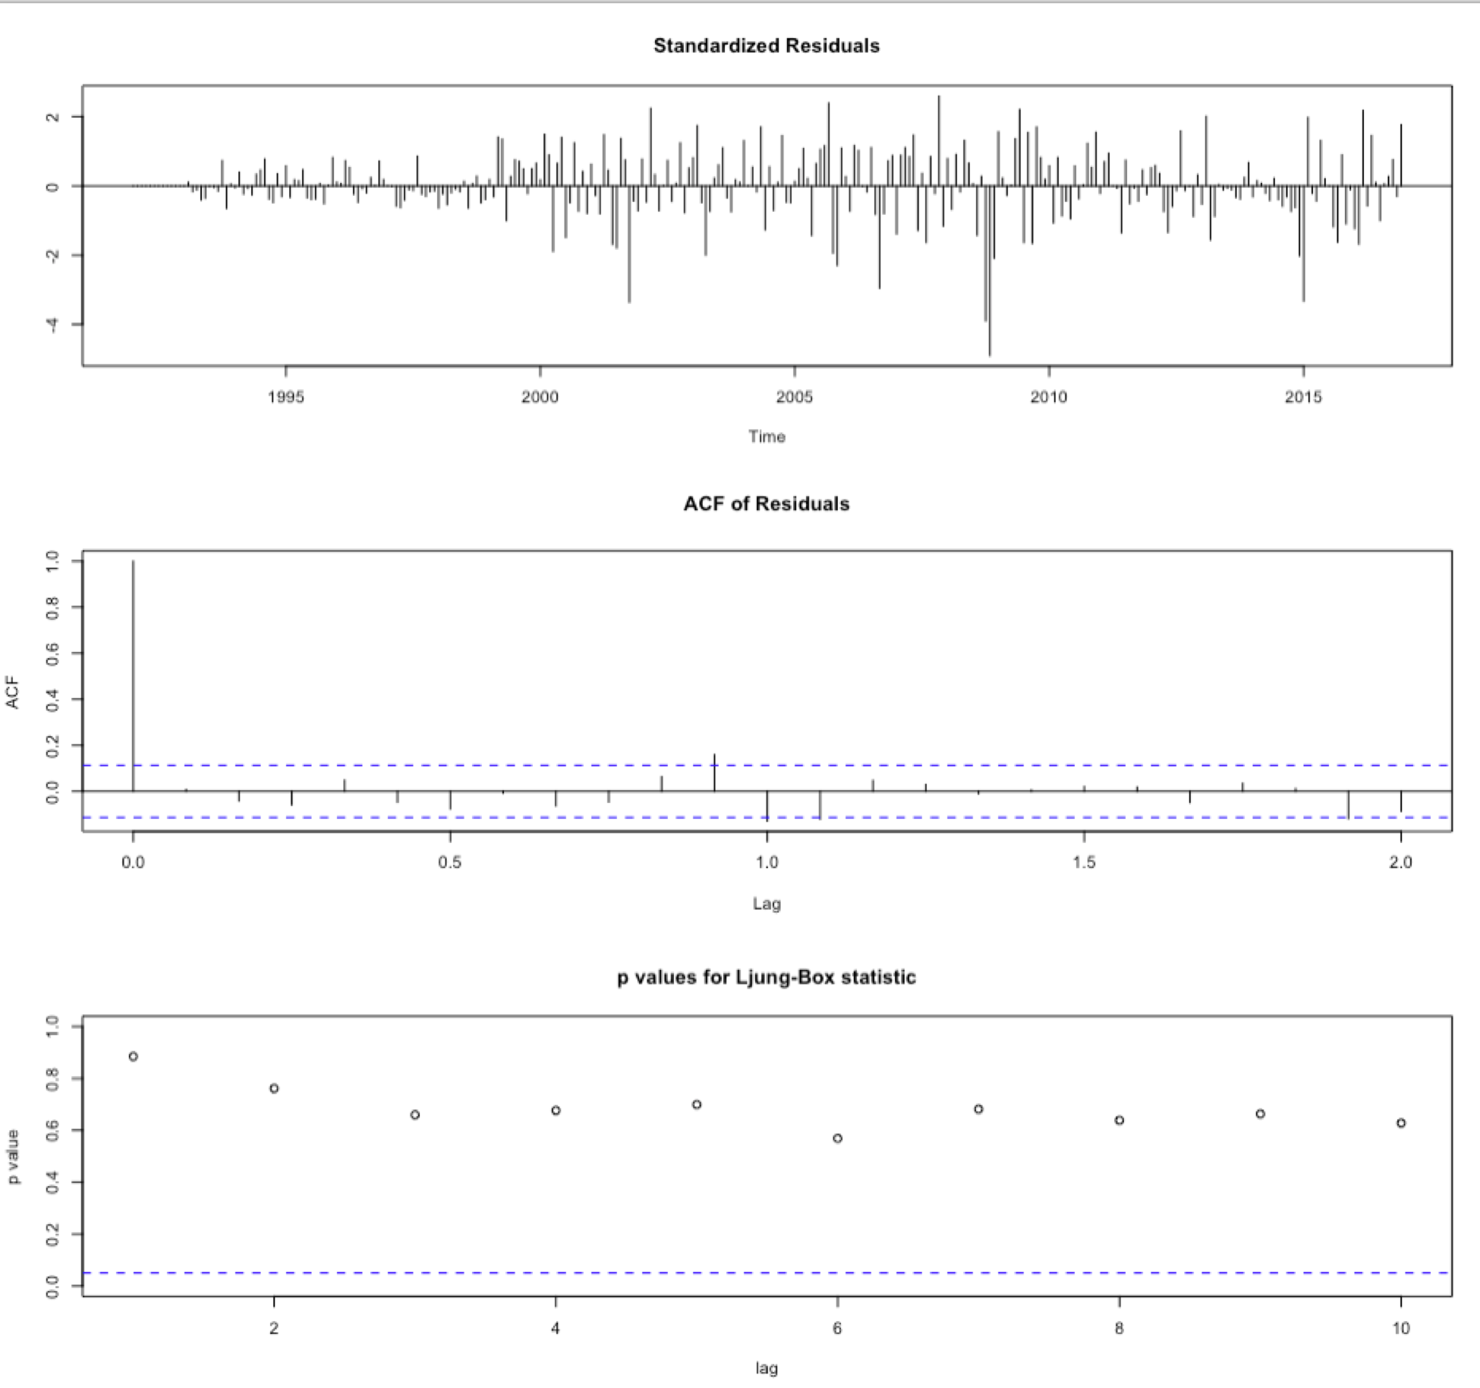
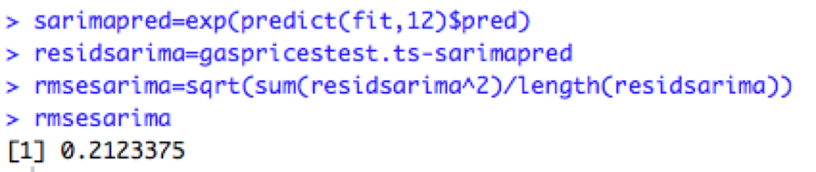
SARIMA Modelling using arima()

Slide 28
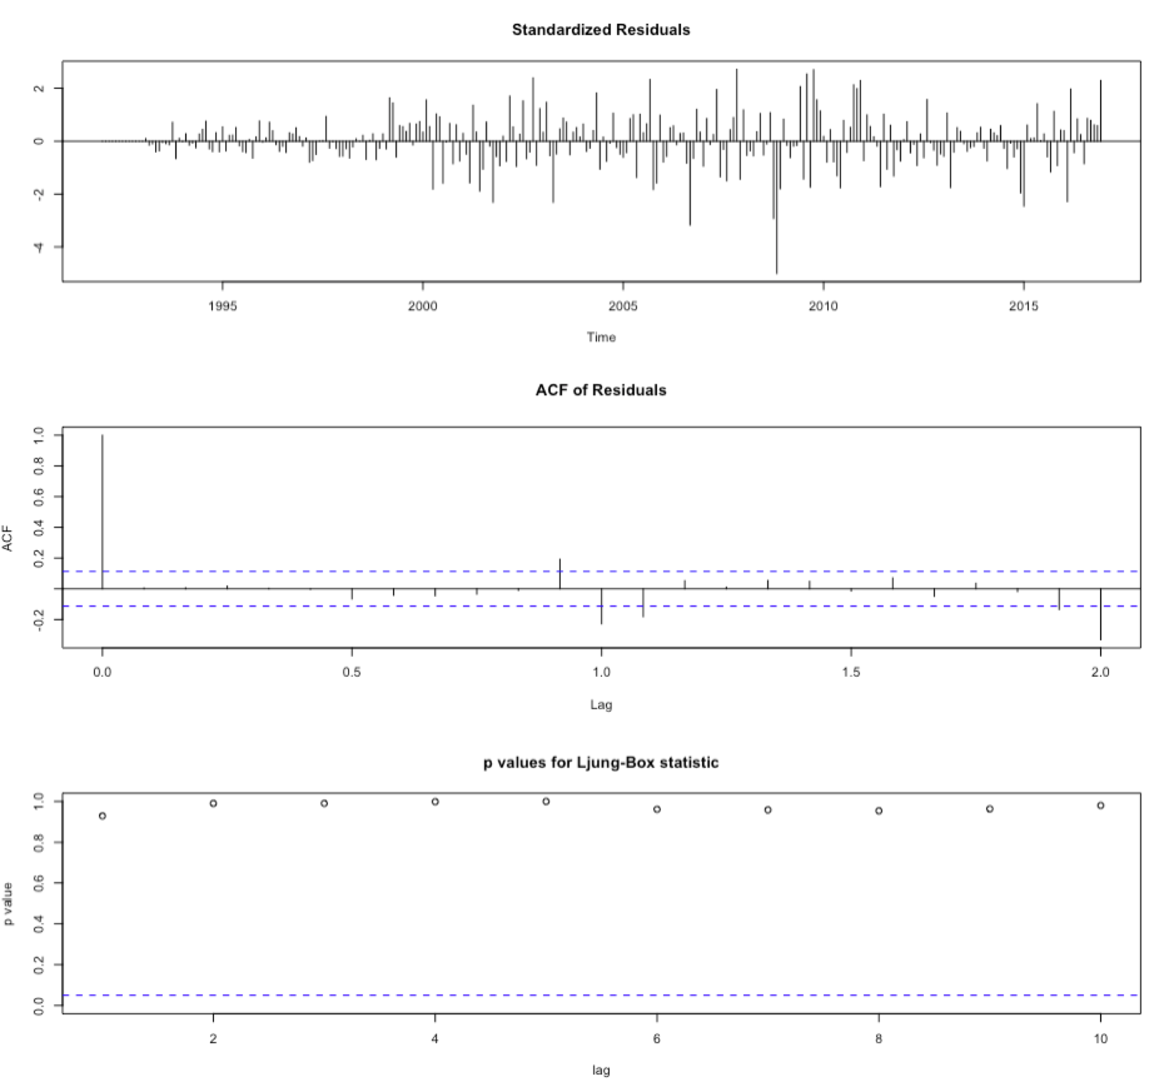
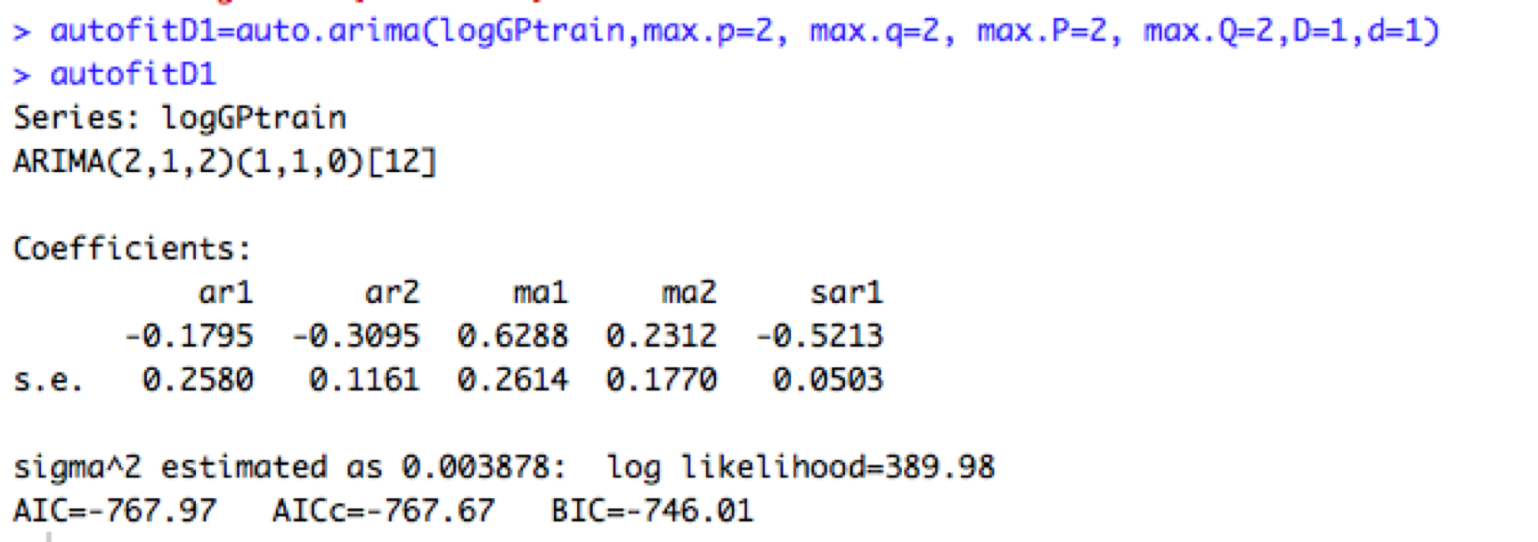
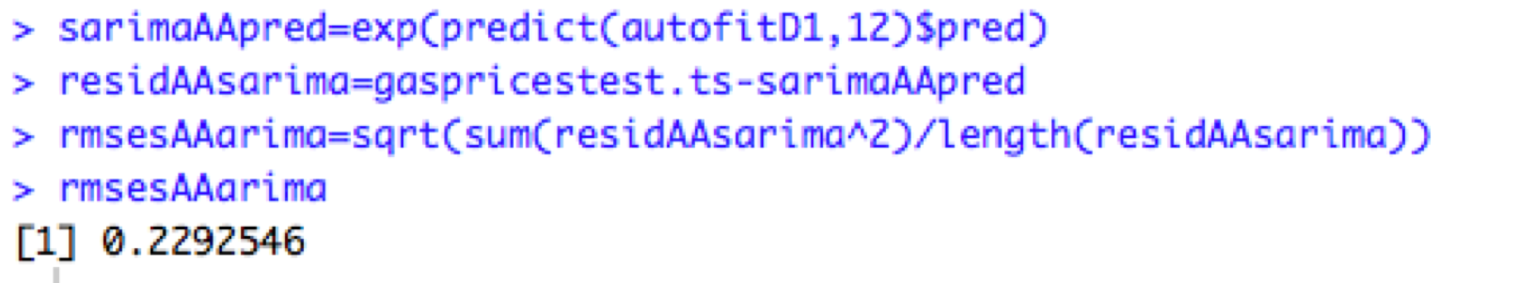
SARIMA using auto.arima()

Slide 29
Change point Analysis
Notes:
Changepoint analysis for time series is an increasingly important aspect of statistics. Simply put, a changepoint is an instance in time where the statistical properties before and after this time point differ. With potential changes naturally occurring in data and many statistical methods assuming a “no change” setup, changepoint analysis is important in both applied and theoretical statistics.
First of all, why would we want to determine change in mean and variance for a time series? Well, my first exposure to changepoint analysis was during Six Sigma training on control charts. The CUSUM control chart allows one to identify when a process has undergone a transformation, leading to a significant shift in the mean. Now, someone with a well-calibrated eyeball and knowledge of the underlying process can easily point out a shift. Take the time series plot above for instance, where it is rather obvious when something has changed dramatically. However, what I’m interested in via this package is the visual capability and the examination of changes in variance. One of the quaint sayings we had in Lean Six Sigma was, “customers don’t feel the mean, they feel the variation”. I believe if you ask a statistician that is drowning in a river that is, on average, 3 feet deep they would agree.
They are a number of changepoint statistical methods and I will show only results for Pruned Exact Linear Time (PELT) and Binary Segmentation. I will not get into the algorithms behind them nor shall I list the pros and cons of each as that is your assignment…should you choose to accept it. At any rate, I still need to get comfortable with the various methods, so who am I too lecture anyone on this topic?

Slide 30
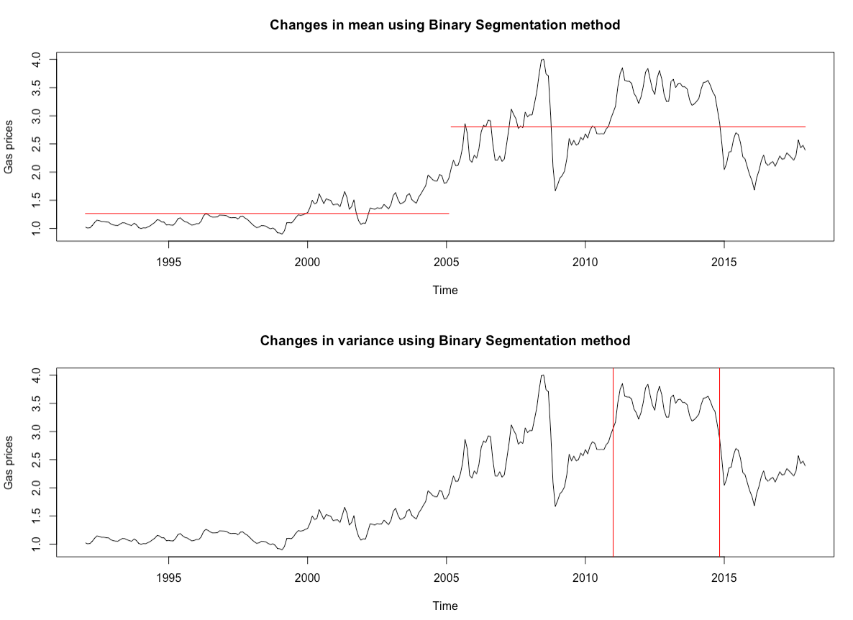
Change Point Analysis- Binary Segmentation
Approximate but fast

Slide 31
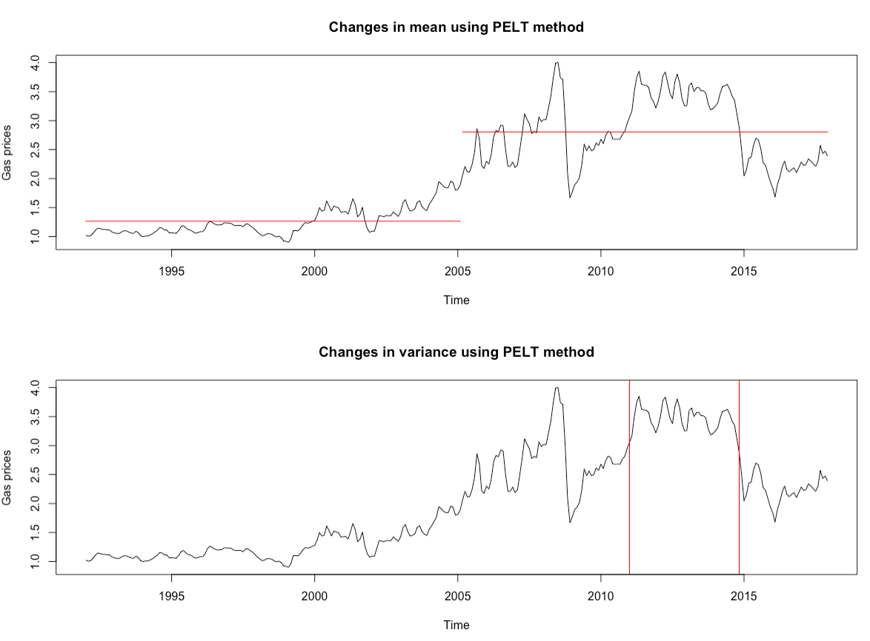
Change Point Analysis - PELT Method
Pruned Exact Linear Time
Fast and exact method

Slide 32
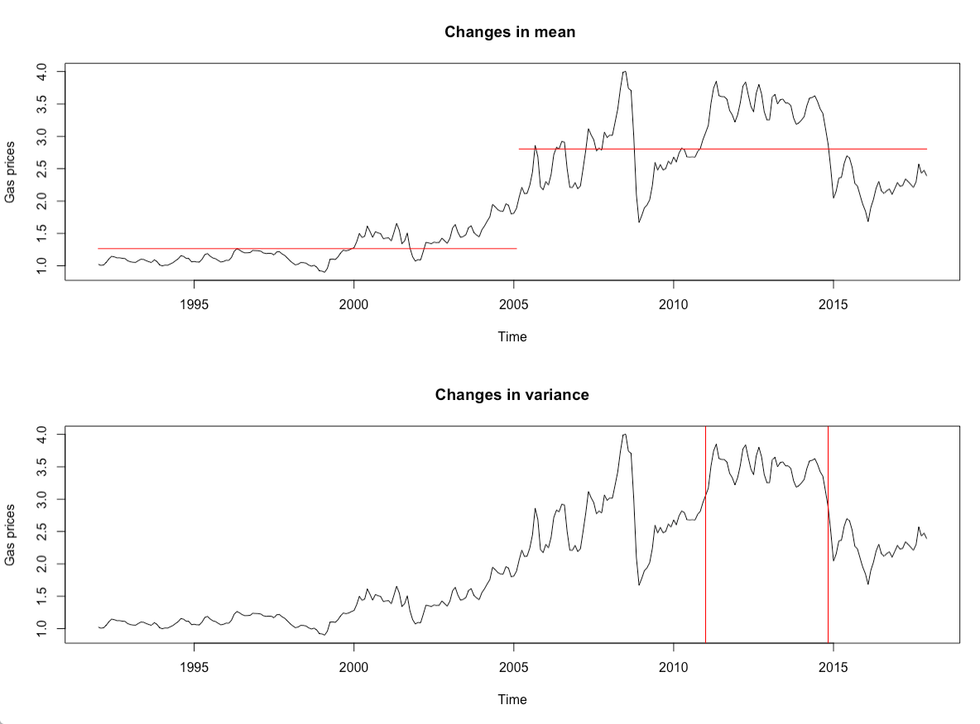
Macroeconomic Factors affecting Gas Prices
Hurricane Katrina
After effects of Recession
Fluctuation in Dollar Value

Slide 33
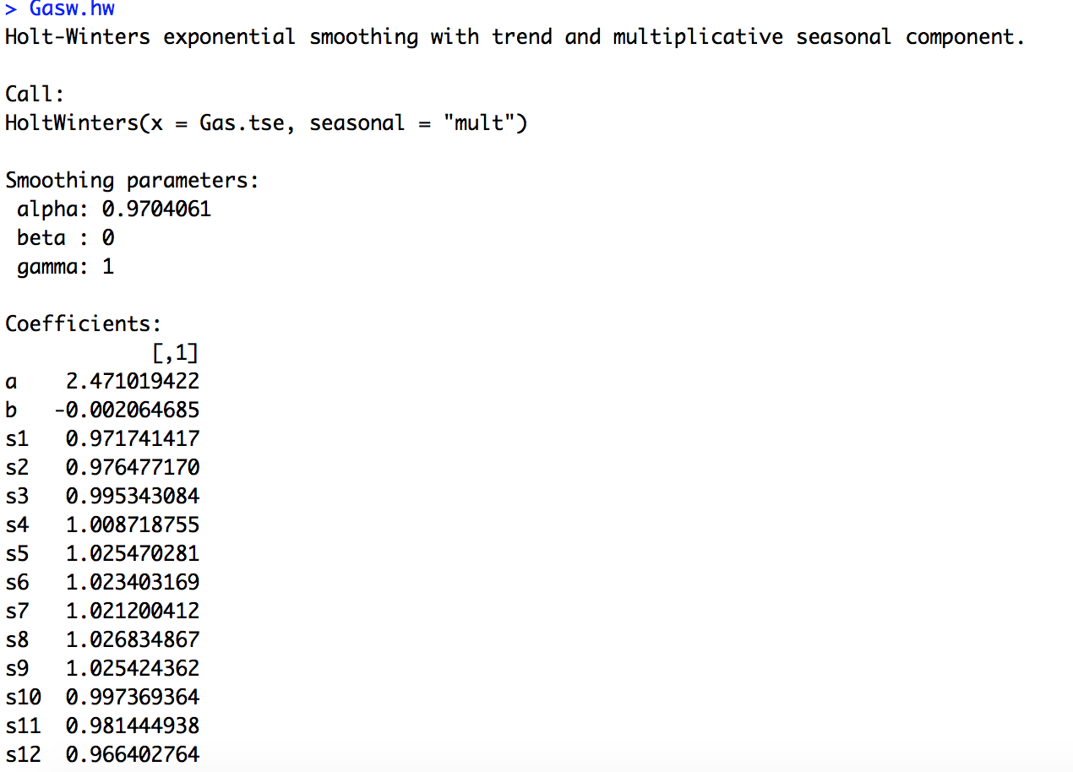
Final Model
> sd(Gas.data)
[1] 0.8946292
> rmse
[1] 0.1361115
> Gasw.predict = predict(Gasw.hw, n.ahead = 1*12)
> Gasw.predict
Jan Feb Mar Apr May Jun Jul Aug Sep
2018 2.399186 2.408862 2.453347 2.484233 2.523371 2.516171 2.508647 2.520368 2.514789
Oct Nov Dec
2018 2.443927 2.402879 2.364056

Slide 34
THANK YOU
Questions?

